Slide 1
Reproducibility in mass spectrometry-based proteomics database searches
Iryna Abramchuk
BNF8166 - November 29, 2023

Slide 2
Mass spectrometer
Digestion
Separation
Mass Analyzer
Mass Analyzer
Liquid Chromatography
Fragmentation
Ionization
(peptide ion)
Proteins
Peptides
MS1 Spectrum
MS2 Spectrum

Slide 3
Mass spectrometer
Digestion
Separation
Mass Analyzer
Mass Analyzer
Liquid Chromatography
Fragmentation
Ionization
(peptide ion)
Proteins
Peptides
MS1 Spectrum
MS2 Spectrum
Database search
Search results

Slide 4
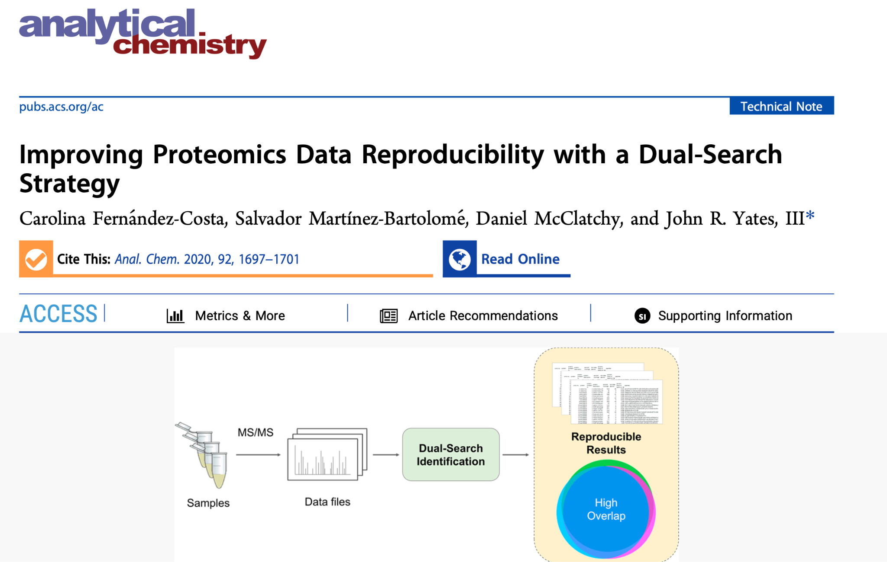
Mass spectrometer
Digestion
Separation
Mass Analyzer
Mass Analyzer
Liquid Chromatography
Fragmentation
Ionization
(peptide ion)
Proteins
Peptides
MS1 Spectrum
MS2 Spectrum
Database search
Create spectral library
Search results
Spectral library

Slide 5
Mass spectrometer
Digestion
Separation
Mass Analyzer
Mass Analyzer
Liquid Chromatography
Fragmentation
Ionization
(peptide ion)
Proteins
Peptides
MS1 Spectrum
MS2 Spectrum
Database search
Create spectral library
Search results
Spectral library
search
Search results

Slide 6
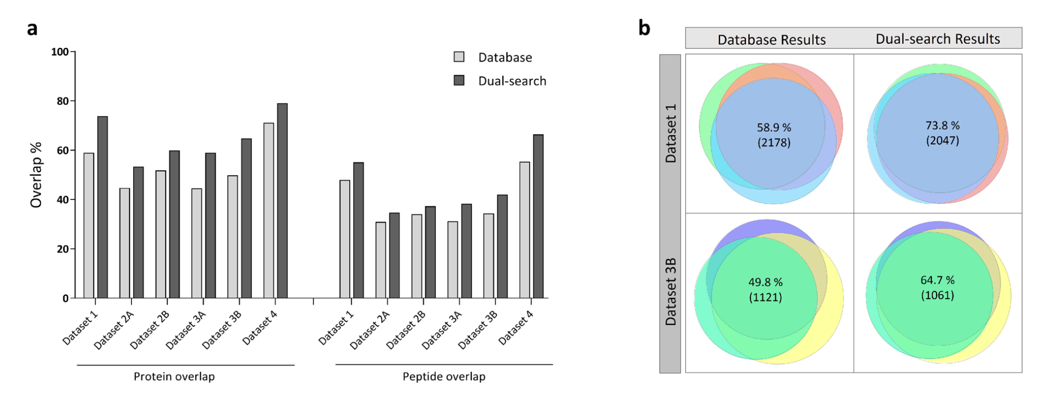
Using the dual search strategy, there is more reproducibility between the proteins/peptides identified across replicate experiments
1. Dual search = more reproducibility among replicates than database search (% and absolute numbers)
2. More overlap between technical replicates than biological replicates

Slide 7
Review of goals
Recreate analysis
Create an automated workflow for a dual-search (Nextflow, Docker)
Install and use their PaCOM visualization tool (Github) for figures
Apply workflow to additional datasets
Compile heterogenous proteomics datasets (different instruments, yields, experiments)
Notes:
#Methods
1. Recreate analysis
- Set up workflow to automate dual-search strategy
- Install PACOM visualization tool
- Download and run dual-search on 4 datasets used
- Compare figures and results (from dual-search strategy only, not additional quantification reproducibility and search space analyses)
2. Apply workflow to additional datasets
- Compile heterogenous set of datasets (different instruments, experiments, yield sizes)
- Run dual-search, run PACOM
- Same effect? (i.e. increased reproducibility)
Additional thoughts
- Try Snakemake or Nextflow
- Try Docker? Might not be applicable to this
- Potential add-on for step 1: recreate dual-search strategy in a git+snakemake+docker pipeline so it is automated and ready to go for the next time I want to use it

Slide 8
Review of goals
Recreate analysis
Create an automated workflow for a dual-search (Nextflow, Docker)
Install and use their PaCOM visualization tool (Github) for figures
Apply workflow to additional datasets
Compile heterogenous proteomics datasets (different instruments, yields, experiments)
Notes:
#Methods
1. Recreate analysis
- Set up workflow to automate dual-search strategy
- Install PACOM visualization tool
- Download and run dual-search on 4 datasets used
- Compare figures and results (from dual-search strategy only, not additional quantification reproducibility and search space analyses)
2. Apply workflow to additional datasets
- Compile heterogenous set of datasets (different instruments, experiments, yield sizes)
- Run dual-search, run PACOM
- Same effect? (i.e. increased reproducibility)
Additional thoughts
- Try Snakemake or Nextflow
- Try Docker? Might not be applicable to this
- Potential add-on for step 1: recreate dual-search strategy in a git+snakemake+docker pipeline so it is automated and ready to go for the next time I want to use it

Slide 9


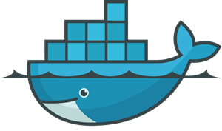
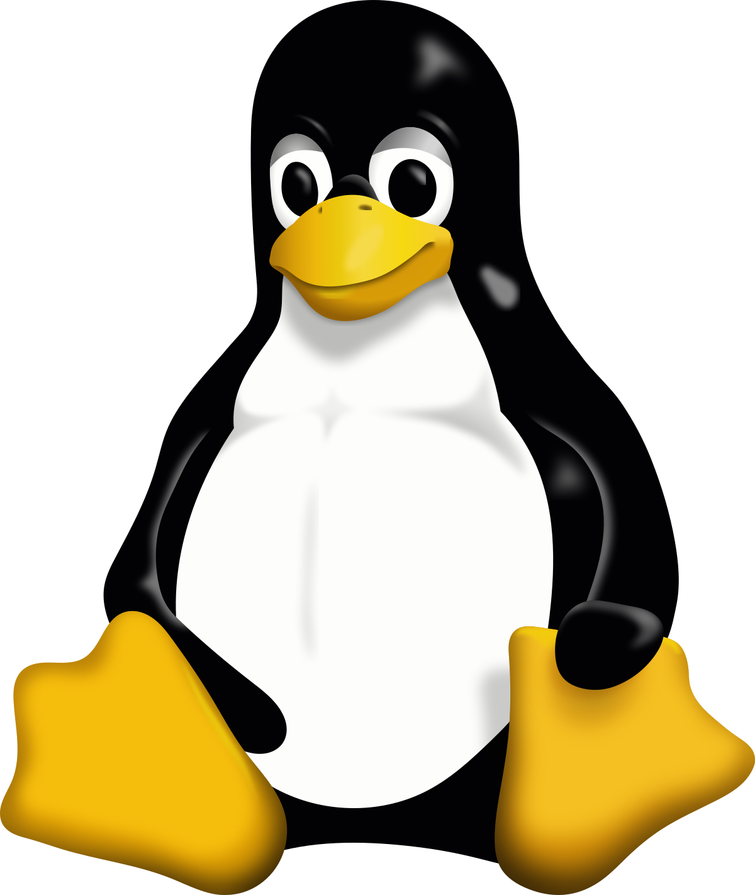


Data layer
Input data
Output data
.raw files
.fasta database
.params comet, spectraST
.params for each process
.pep.xml, prot.xml database search results
.pep.xml, prot.xml spectral library search results
.txt quick stats of overlap
Database search
Create spectral library
Spectral library search
rawconverter (v1.1.0.19)
decoyFASTA or msstitch (?)
comet (from TPP v5.2.0)
peptideprophet (from TPP v5.2.0)
spectrast -create (v5.0)
spectrast -search (v5.0)
peptideprophet (from TPP v5.2.0)
Summary stats
quickstats
Workflow management
Versioning management
Environment layer (Docker)
Execution layer
git (& GitHub) repo
spctools/tpp:version5.2
(built on BioContainers Ubuntu image)
WSL2 (Windows Subsystem for Linux)
Ubuntu 20.04.6

Slide 10
Data layer
Input data
Output data
.raw files
.fasta database
.params comet, spectraST
.pep.xml, prot.xml database search results
.pep.xml, prot.xml spectral library search results
nextflow.config
Versioning management
Environment layer (Docker)
Execution layer
git (& GitHub) repo
spctools/tpp:version5.2
chambm/pwiz-skyline:3.0.22335-b595b19
WSL2 (Windows Subsystem for Linux)
Ubuntu 20.04.6

Slide 11
Data layer
Input data
Output data
.raw files
.fasta database
.params comet, spectraST
.pep.xml, prot.xml database search results
.pep.xml, prot.xml spectral library search results
nextflow.config
🧍
Workflow management
Manual ‘tinkering’
Versioning management
Environment layer (Docker)
Execution layer
git (& GitHub) repo
spctools/tpp:version5.2
chambm/pwiz-skyline:3.0.22335-b595b19
WSL2 (Windows Subsystem for Linux)
Ubuntu 20.04.6

Slide 12
Data layer
Input data
Output data
.raw files
.fasta database
.params comet, spectraST
.pep.xml, prot.xml database search results
.pep.xml, prot.xml spectral library search results
nextflow.config
Database search
Data preprocessing
Create spectral library
comet
xinteract (proteinprophet)
msconvert
decoyFASTA
spectrast -create
🧍
spectrast -search
xinteract
Workflow management
Spectral library search
Manual ‘tinkering’
Versioning management
Environment layer (Docker)
Execution layer
git (& GitHub) repo
spctools/tpp:version5.2
chambm/pwiz-skyline:3.0.22335-b595b19
WSL2 (Windows Subsystem for Linux)
Ubuntu 20.04.6

Slide 13
Data layer
Input data
Output data
.raw files
.fasta database
.params comet, spectraST
.pep.xml, prot.xml database search results
.pep.xml, prot.xml spectral library search results
nextflow.config
process → function, method, script etc.
performs task(s)
“msconvert”, “comet”
workflow → organise processes
“Data preprocessing”, “Create spectral library”
Database search
Data preprocessing
Create spectral library
comet
xinteract (proteinprophet)
msconvert
decoyFASTA
spectrast -create
🧍
spectrast -search
xinteract
Workflow management
Spectral library search
Manual ‘tinkering’
Versioning management
Environment layer (Docker)
Execution layer
git (& GitHub) repo
spctools/tpp:version5.2
chambm/pwiz-skyline:3.0.22335-b595b19
WSL2 (Windows Subsystem for Linux)
Ubuntu 20.04.6

Slide 14
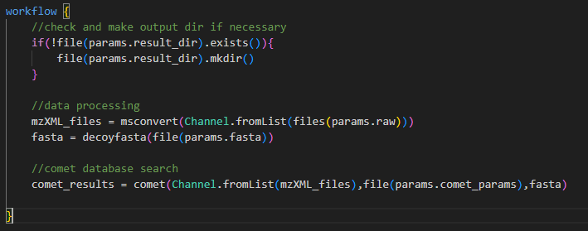
1
2
3
process:
msconvert
process:
comet
channel:
raw_files
channel:
mzXML
run1.raw
run1.mzXML
msconvert ${rawx_file} -o ${mzXML_file}
comet ${mzXML_file} -o ${pepXML_file}
run2.raw
run2.mzXML
run3.raw
run3.mzXML

Slide 15
1
1
1
process:
msconvert
process:
comet
channel:
raw_files
channel:
mzXML
run1.raw
run1.mzXML
msconvert ${rawx_file} -o ${mzXML_file}
comet ${mzXML_file} -o ${pepXML_file}
run2.raw
run2.mzXML
run3.raw
run3.mzXML

Slide 16
1
1
process:
msconvert
process:
comet
channel:
raw_files
channel:
mzXML
run1.raw
run1.mzXML
msconvert ${rawx_file} -o ${mzXML_file}
comet ${mzXML_file} -o ${pepXML_file}
run2.raw
run2.mzXML
run3.raw
run3.mzXML

Slide 17
1
I did not figure out how to set up dependencies between processes and/or workflows
So I used manual intervention
1
process:
msconvert
process:
comet
channel:
raw_files
channel:
mzXML
run1.raw
run1.mzXML
msconvert ${rawx_file} -o ${mzXML_file}
comet ${mzXML_file} -o ${pepXML_file}
run2.raw
run2.mzXML
run3.raw
run3.mzXML

Slide 18
Data layer
Input data
Output data
.raw files
.fasta database
.params comet, spectraST
.pep.xml, prot.xml database search results
.pep.xml, prot.xml spectral library search results
nextflow.config
Filter database results at 1% FDR
Database search
Data preprocessing
Create spectral library
comet
xinteract (proteinprophet)
msconvert
decoyFASTA
spectrast -create
Filter spectral results at 1% FDR
🧍
spectrast -search
xinteract
PaCOM, visualization, overlap analysis
Workflow management
Spectral library search
Manual ‘tinkering’
Versioning management
Environment layer (Docker)
Execution layer
git (& GitHub) repo
spctools/tpp:version5.2
chambm/pwiz-skyline:3.0.22335-b595b19
WSL2 (Windows Subsystem for Linux)
Ubuntu 20.04.6

Slide 19
Review of goals
Recreate analysis
Create an automated workflow for a dual-search (Nextflow, Docker)
Install and use their PaCOM visualization tool (Github) for figures
Apply workflow to additional datasets
Compile heterogenous proteomics datasets (different instruments, yields, experiments)
Notes:
#Methods
1. Recreate analysis
- Set up workflow to automate dual-search strategy
- Install PACOM visualization tool
- Download and run dual-search on 4 datasets used
- Compare figures and results (from dual-search strategy only, not additional quantification reproducibility and search space analyses)
2. Apply workflow to additional datasets
- Compile heterogenous set of datasets (different instruments, experiments, yield sizes)
- Run dual-search, run PACOM
- Same effect? (i.e. increased reproducibility)
Additional thoughts
- Try Snakemake or Nextflow
- Try Docker? Might not be applicable to this
- Potential add-on for step 1: recreate dual-search strategy in a git+snakemake+docker pipeline so it is automated and ready to go for the next time I want to use it

Slide 20
Review of goals
Recreate analysis
Create an automated workflow for a dual-search (Nextflow, Docker)
Install and use their PaCOM visualization tool (Github) for figures
Apply workflow to additional datasets
Compile heterogenous proteomics datasets (different instruments, yields, experiments)
Notes:
#Methods
1. Recreate analysis
- Set up workflow to automate dual-search strategy
- Install PACOM visualization tool
- Download and run dual-search on 4 datasets used
- Compare figures and results (from dual-search strategy only, not additional quantification reproducibility and search space analyses)
2. Apply workflow to additional datasets
- Compile heterogenous set of datasets (different instruments, experiments, yield sizes)
- Run dual-search, run PACOM
- Same effect? (i.e. increased reproducibility)
Additional thoughts
- Try Snakemake or Nextflow
- Try Docker? Might not be applicable to this
- Potential add-on for step 1: recreate dual-search strategy in a git+snakemake+docker pipeline so it is automated and ready to go for the next time I want to use it

Slide 21
Review of goals
Recreate analysis
Create an automated workflow for a dual-search (Nextflow, Docker)
Install and use their PaCOM visualization tool (Github) for figures
Apply workflow to additional datasets
Compile heterogenous proteomics datasets (different instruments, yields, experiments)
Notes:
#Methods
1. Recreate analysis
- Set up workflow to automate dual-search strategy
- Install PACOM visualization tool
- Download and run dual-search on 4 datasets used
- Compare figures and results (from dual-search strategy only, not additional quantification reproducibility and search space analyses)
2. Apply workflow to additional datasets
- Compile heterogenous set of datasets (different instruments, experiments, yield sizes)
- Run dual-search, run PACOM
- Same effect? (i.e. increased reproducibility)
Additional thoughts
- Try Snakemake or Nextflow
- Try Docker? Might not be applicable to this
- Potential add-on for step 1: recreate dual-search strategy in a git+snakemake+docker pipeline so it is automated and ready to go for the next time I want to use it

Slide 22
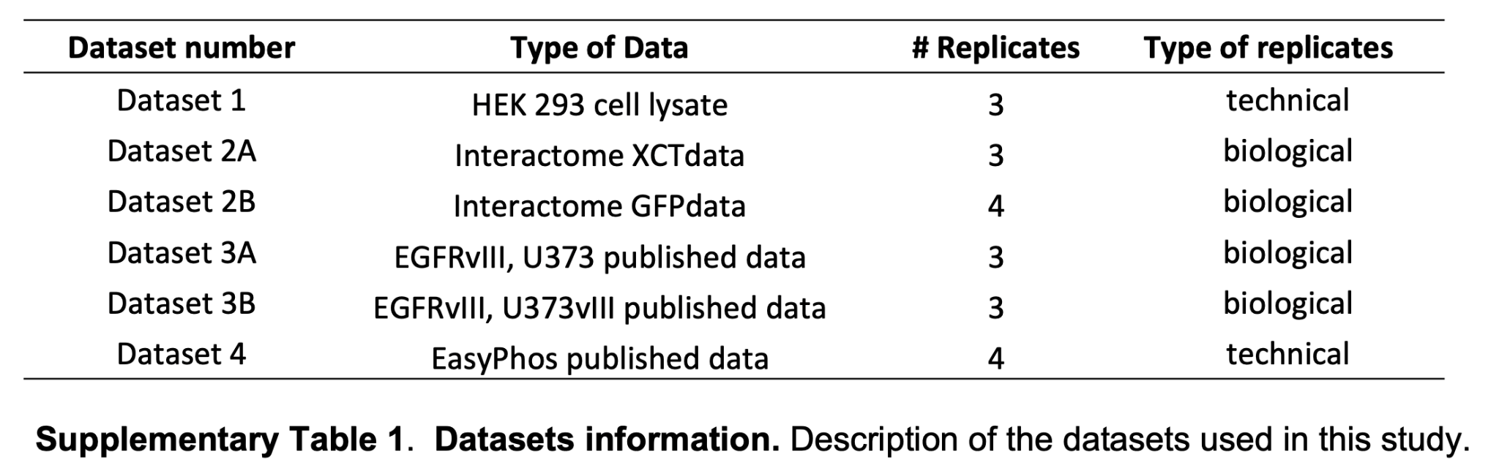
Additional analysis
3 biological replicates
HEK293 cell lysate
Bruker instrument
(Control runs from someone’s old experiments on my computer)

Slide 23
Number of peptide-spectrum-matches, peptides and proteins identified
 |  | Database search |  |  | Dual search
 | Sample | PSM | Peptides | Proteins | PSM | Peptides | Proteins
Reproduced results (IA) | Rep 1 | 8025 | 6121 | 1393 | 7068 | 5505 | 1276
 | Rep 2 | 16172 | 6792 | 1586 | 13330 | 5945 | 1401
 | Rep 3 | 14228 | 6729 | 1578 | 12387 | 5998 | 1420
Fernández-Costa et al (OG) | Rep 1 | 8614 | 6324 | 1409 | 8604 | 5807 | 1167
 | Rep 2 | 17066 | 6681 | 1588 | 19105 | 6297 | 1329
 | Rep 3 | 15327 | 6578 | 1559 | 16772 | 6204 | 1323
Overlap between peptide, protein identifications across all replicates
 |  | Peptide overlap | Protein overlap
Reproduced results (IA) | Database search | 31.3% (3166) | 45.7% (986)
 | Dual search | 32.6% (2844) | 51.4% (943)
Fernández-Costa et al (OG) | Database search | 31.2% (3256) | 44.5% (974)
 | Dual search | 38.3% (3430) | 58.9% (948)

Slide 24
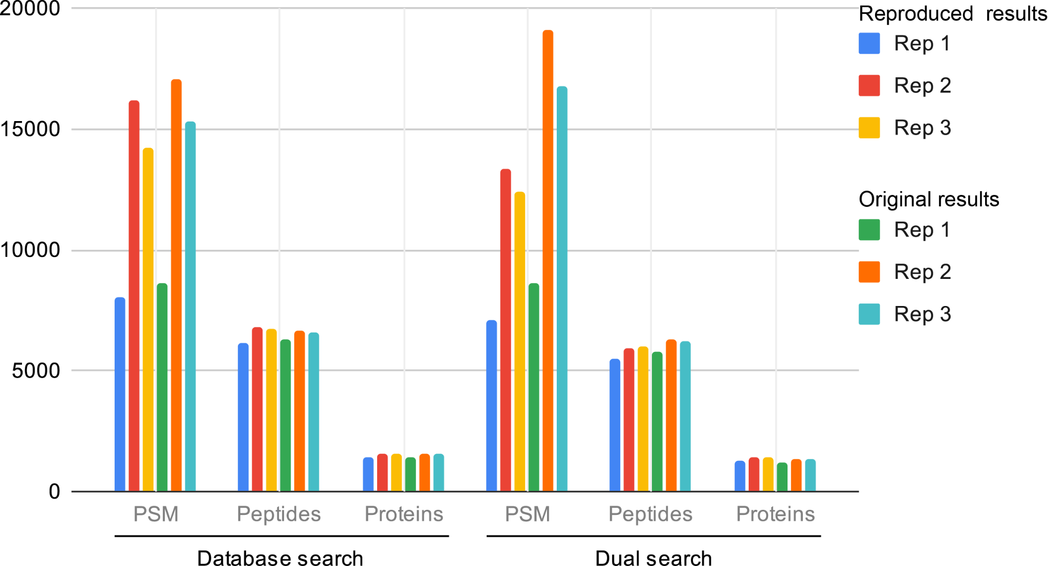

Slide 25
Reproduced results
Fernández-Costa et al.
 |  | Peptide overlap | Protein overlap
Reproduced results (IA) | Database search | 31.3% (3166) | 45.7% (986)
 | Dual search | 32.6% (2844) | 51.4% (943)
Fernández-Costa et al (OG) | Database search | 31.2% (3256) | 44.5% (974)
 | Dual search | 38.3% (3430) | 58.9% (948)
Peptide overlap
Protein overlap
Peptide overlap
Protein overlap
31.3%
(3166)
45.7%
(986)
31.2%
(3256)
44.5%
(974)
Database search
Database search
32.6%
(2844)
51.4%
(943)
38.3%
(3430)
58.9%
(948)
Dual search
Dual search

Slide 26
Number of peptide-spectrum-matches, peptides and proteins identified
 |  | Database search |  |  | Dual search
 | Sample | PSM | Peptides | Proteins | PSM | Peptides | Proteins
Reproduced results (IA) | Rep 1 | 14835 | 6984 | 1429 | 14706 | 6114 | 1134
 | Rep 2 | 16412 | 9022 | 1627 | 17536 | 8246 | 1425
 | Rep 3 | 16023 | 7125 | 1566 | 17304 | 6433 | 1299
Fernández-Costa et al (OG) | Rep 1 | 15033 | 7248 | 1517 | 16688 | 6811 | 1262
 | Rep 2 | 17612 | 9192 | 1804 | 18339 | 8198 | 1469
 | Rep 3 | 16494 | 7032 | 1573 | 17941 | 6518 | 1315
Overlap between peptide, protein identifications across all replicates
 |  | Peptide overlap | Protein overlap
Reproduced results (IA) | Database search | 33.2 % (4083) | 49.5% (1156)
 | Dual search | 40.9% (3856) | 60.8% (1004)
Fernández-Costa et al (OG) | Database search | 34.3 % (4125) | 49.8 % (1121)
 | Dual search | 42.5 % (4275) | 64.7 % (1061)

Slide 27
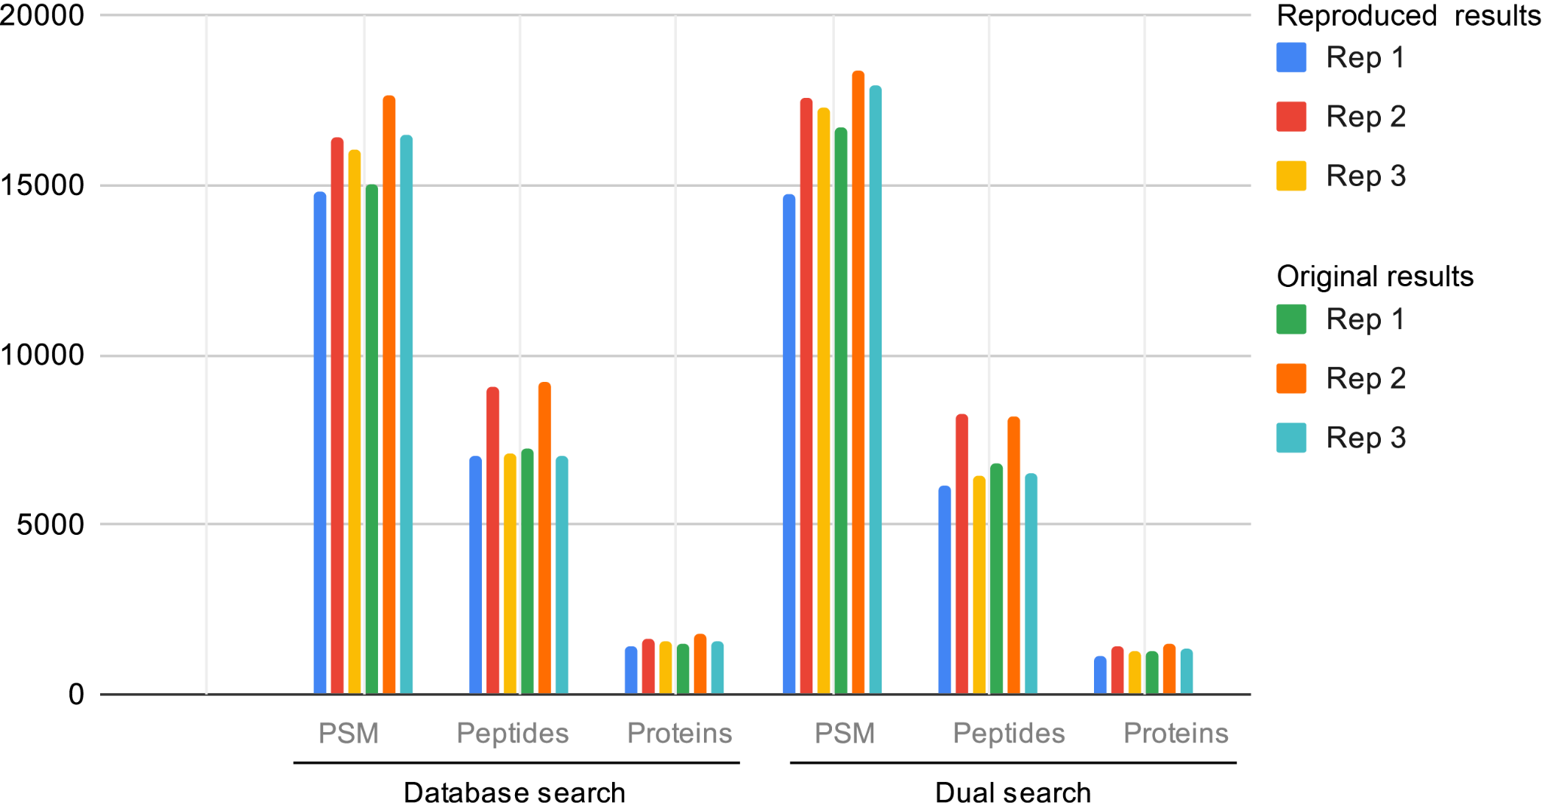

Slide 28
Reproduced results
Fernández-Costa et al.
Peptide overlap
Protein overlap
Peptide overlap
Protein overlap
33.2%
(4083)
49.5%
(1156)
34.3%
(4125)
49.8%
(1121)
Database search
Database search
40.9%
(3856)
60.8%
(1004)
42.5%
(4275)
64.7%
(1061)
Dual search
Dual search

Slide 29
HEK293 cell lysates
Number of peptide-spectrum-matches, peptides and proteins identified
 |  | Database search |  |  | Dual search
 | Sample | PSM | Peptides | Proteins | PSM | Peptides | Proteins
HEK293 cell lysates | Rep 1 | 11823 | 6786 | 1463 | 10622 | 5972 | 1304
 | Rep 2 | 17339 | 7936 | 1696 | 15605 | 6933 | 1526
 | Rep 3 | 15910 | 6805 | 1566 | 14319 | 5987 | 1463
Overlap between peptide, protein identifications across all replicates
 |  | Peptide overlap | Protein overlap
HEK293 cell lysates | Database search | 32.2% (3211) | 47.3% (1046)
 | Dual search | 41.2% (3085) | 60.2% (1004)

Slide 30
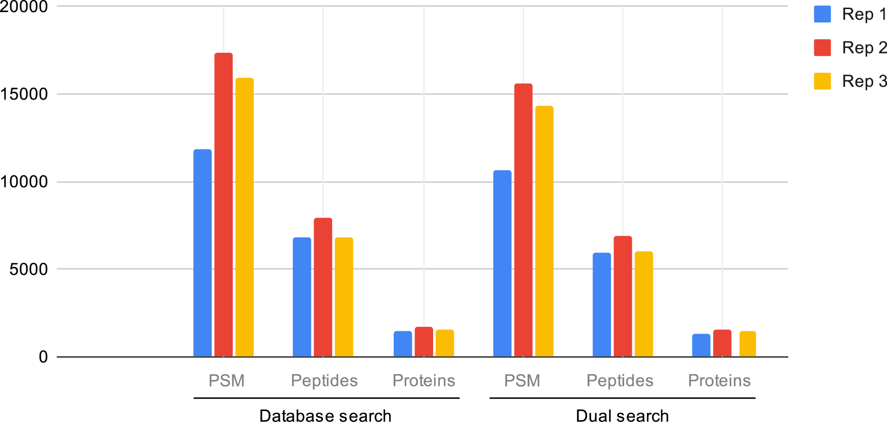
HEK293 cell lysates

Slide 31
HEK293 cell lysates
 |  | Peptide overlap | Protein overlap
HEK293 cell lysates | Database search | 32.2% (3211) | 47.3% (1046)
 | Dual search | 41.2% (3085) | 60.2% (1004)
Peptide overlap
Protein overlap
32.2%
(3211)
47.3%
(1046)
Database search
41.2%
(3085)
60.2%
(1004)
Dual search

Slide 32
Conclusions of reproducibility analysis
Identical reproduction of author’s results ✘
Lack of methods details, exact files to perfectly recreate analysis
Reproduction of method effectiveness ✔
Using the dual search strategy, there is more reproducibility between the proteins/peptides identified across replicate experiments
Peptide overlap
Protein overlap
Database search
32.2%
(3211)
47.3%
(1046)
Dual search
41.2%
(3085)
60.2%
(1004)

Slide 33
Reproducibility in bioinformatics
Awareness of issue
Knowledge of tools/proper practice
Incentive

Slide 34
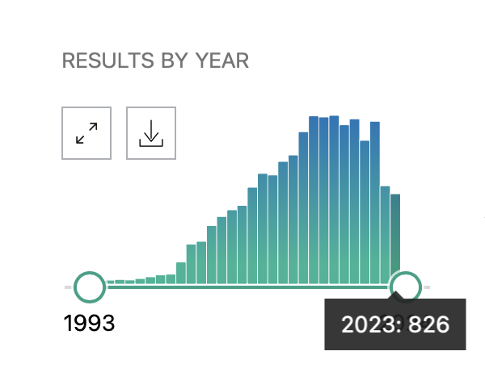

Reproducibility in bioinformatics
Awareness of issue
Knowledge of tools/proper practice
PubMed: “reproducibility in bioinformatics”
Incentive

Slide 35
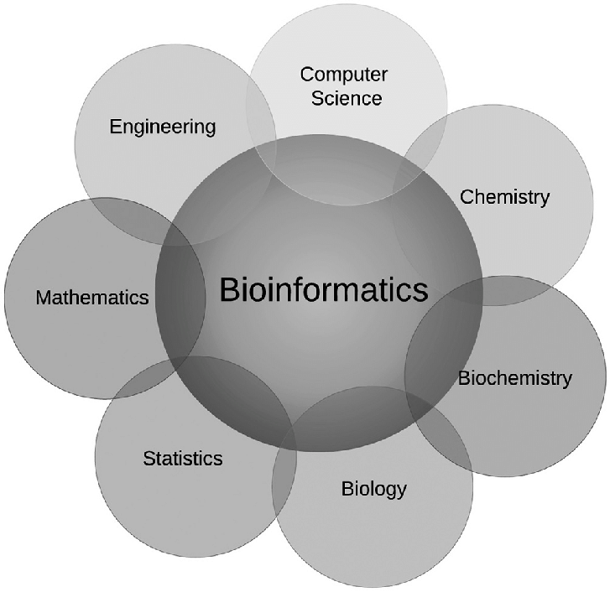
Reproducibility in bioinformatics
Awareness of issue
Knowledge of tools/proper practice
Incentive

Slide 36


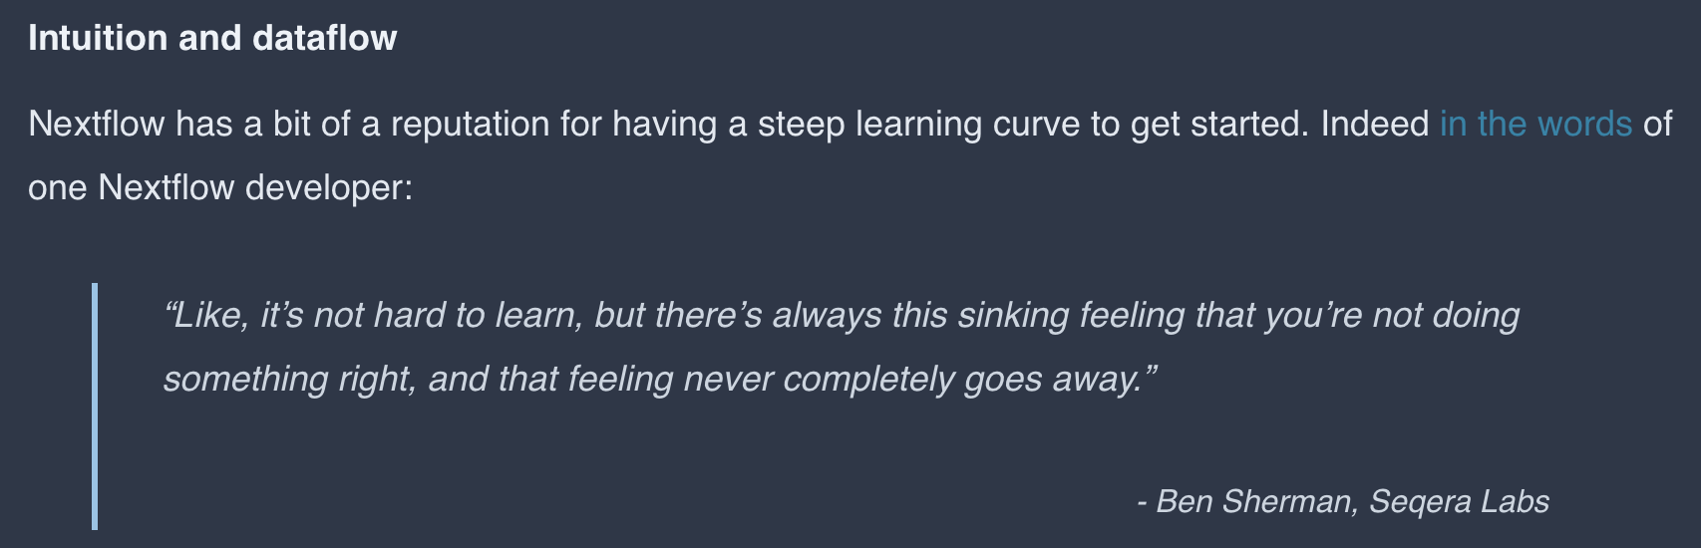
Reproducibility in bioinformatics
Awareness of issue
Knowledge of tools/proper practice
Incentive

Slide 37
Thank you!

